Slide 1


Bank Customer Churn Analysis and Prediction
This presentation provides a comprehensive analysis of customer churn in a banking environment. We'll examine the data patterns, identify key factors influencing customer decisions to leave, and present actionable insights to improve customer retention based on our predictive model.
by Shubham Mukherjee

Slide 2
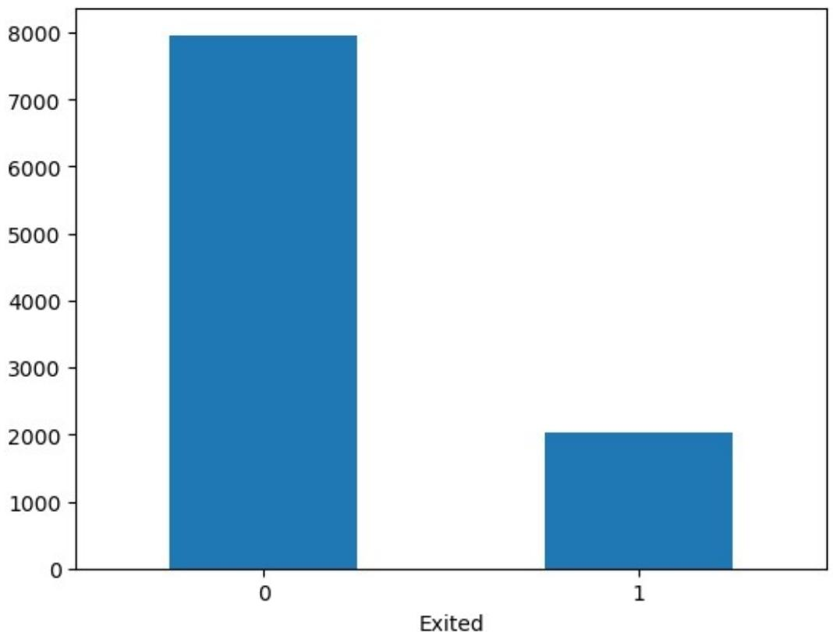
Data Imbalance
The data shows a significant imbalance between customers who stayed with the bank (7963) versus those who exited (2037). This imbalance (approximately 80% vs 20%) is important to consider when building predictive models, as it may lead to biased predictions favoring the majority class. Our analysis will need to account for this imbalance using techniques like class weighting or balanced sampling.

Slide 3
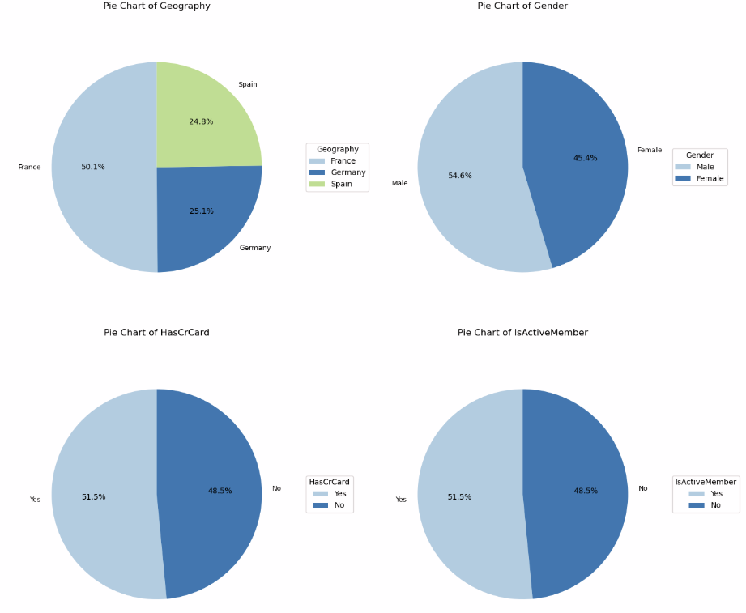
Categorical Distribution And Analysis

Slide 4
Categorical Distribution And Analysis
The percentage of male customers is more as compared to female customers in the dataset.
The percentage of customers from France constitute 50% of the customers
Other categorical variables show a relatively uniform distribution, providing a good basis for analysis.

Slide 5
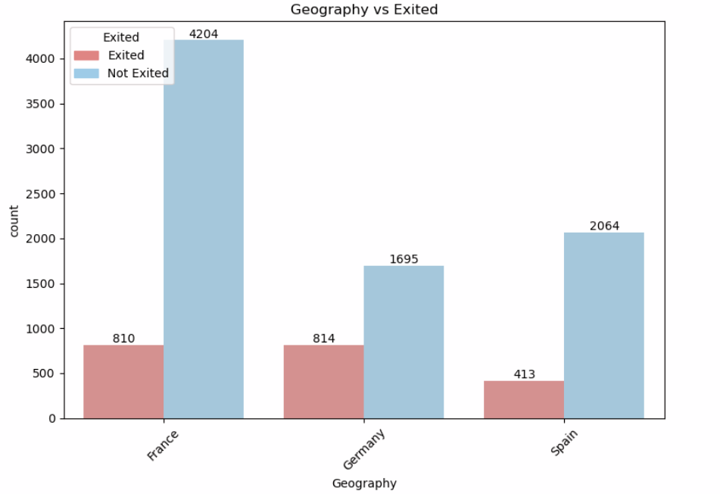
Subcategories – Churn Relationship
Germany has the highest churn rate at approximately 32.3%. This is significantly higher than the other two countries.
France has the lowest churn rate at approximately 16.2%.
Spain's churn rate is close to France's at approximately 16.6%.
The Chi-Square test results (Chi2: 301.678041, p-value: 4.707920e-64) confirm a strong statistical association between geography and customer churn, suggesting that location is a significant factor in predicting customer exit.

Slide 6
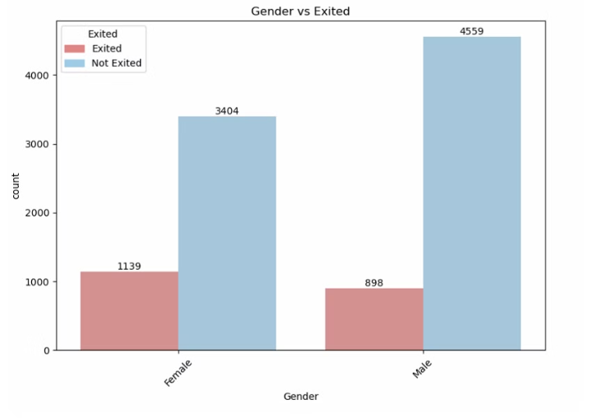
Female Customers
Female customers show a significantly higher churn rate (approximately 25.07%) compared to male customers (approximately 16.45%. This gender disparity suggests that female customers may have different needs or expectations that aren't being adequately met by current banking services.
The Chi-Square test results (Chi2: 112.918571, p-value: 2.248210e-26) confirm a strong statistical association between gender and customer churn.
Male Customers
Male customers demonstrate better retention rates overall. Understanding what drives this higher loyalty among male customers could provide insights for improving retention strategies for female customers.
The significant difference in churn rates between genders indicates a need for gender-specific retention strategies and possibly different service offerings tailored to each group's preferences.

Slide 7
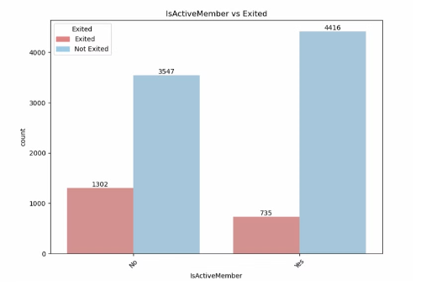

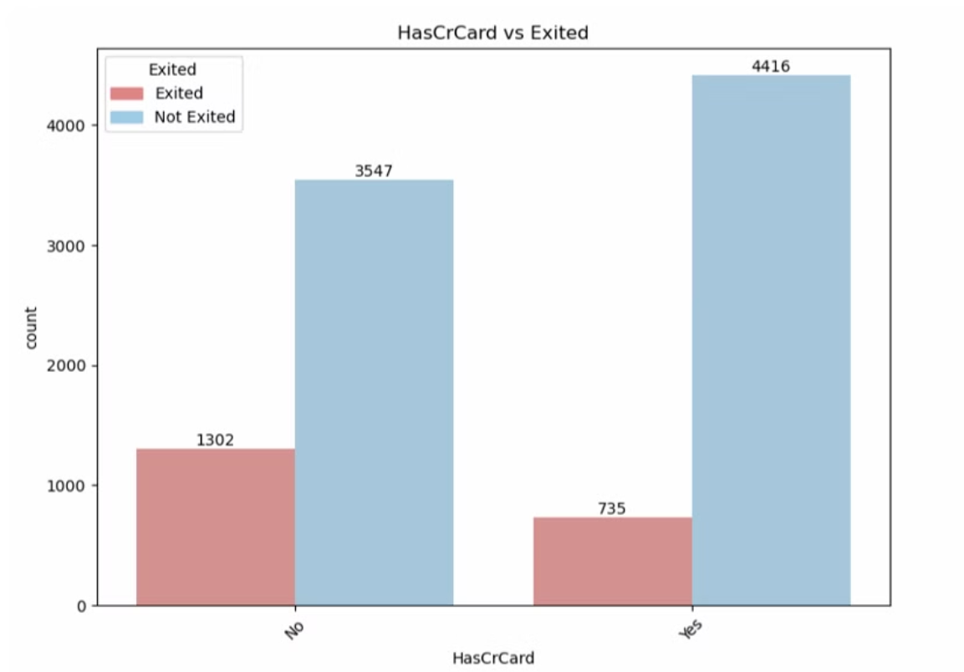
Activity Status Impact
Inactive members show significantly higher churn rates (approximately 26.85%) compared to active members (approximately 14.27%). The Chi-Square test results (Chi2: 242.985342, p-value: 8.785858e-55) confirm a strong statistical association between activity status and customer churn. This suggests that customer engagement is a critical factor in retention, and efforts should be made to increase activity levels among dormant accounts.
Credit Card Ownership
Customers without credit cards tend to churn more frequently than those with credit cards. The Chi-Square test results (Chi2: 242.985342, p-value: 8.785858e-55) indicate a strong statistical relationship.
This suggests that credit card products create stronger customer relationships and may serve as an effective retention tool. The bank should consider targeted credit card promotions for at-risk customers.

Slide 8




Categorical Variables and Churn Relationship
Geography Impact
Germany has the largest number of churners followed by Spain, indicating potential regional factors affecting customer satisfaction.
Gender Differences
Female churners are more as compared to male customers, suggesting possible gender-specific needs or concerns.
Credit Card Influence
Those not having credit cards tend to churn more, highlighting the importance of this product offering.
Member Activity
Customers who are not active members tend to churn more, indicating engagement is a key retention factor.

Slide 9
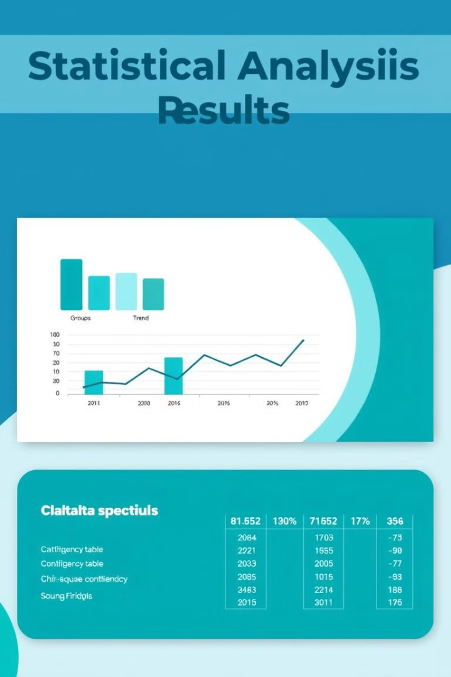
Statistical Association Tests
Feature
Chi2
p-value
Geography
301.678041
4.707920e-64
Gender
112.918571
2.248210e-26
HasCrCard
242.985342
8.785858e-55
IsActiveMember
242.985342
8.785858e-55
Chi-Square test results suggest strong associations between categorical features and the target variable (Exited), given the very low p-values (all < 0.05). This confirms we should include all the categorical columns in our predictive model.

Slide 10
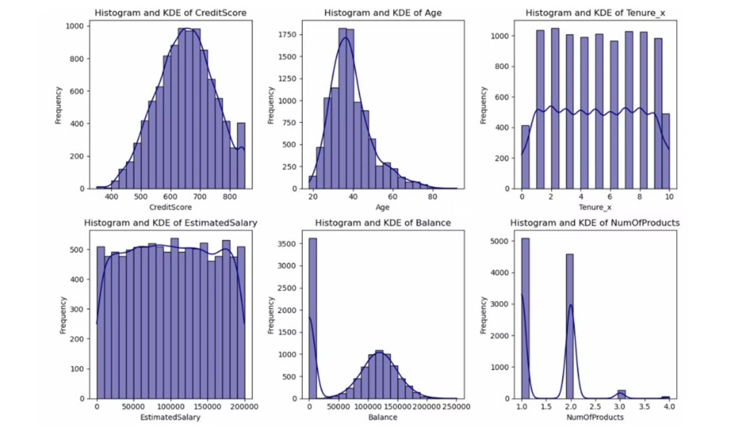
Numerical Column Distribution

Slide 11
Numerical Column Analysis
Credit Score Distribution
Credit score data is slightly left skewed, indicating most customers have above-average credit scores.
Age Distribution
Age is right skewed, showing a larger proportion of younger customers with fewer older clients.
Discrete Variables
Tenure and Number of products are discrete numerical columns with limited unique values.
Salary and Balance
Estimated Salary has a flat curve indicating uniform distribution, while Balance is mostly normal except for one skewed data point.

Slide 12
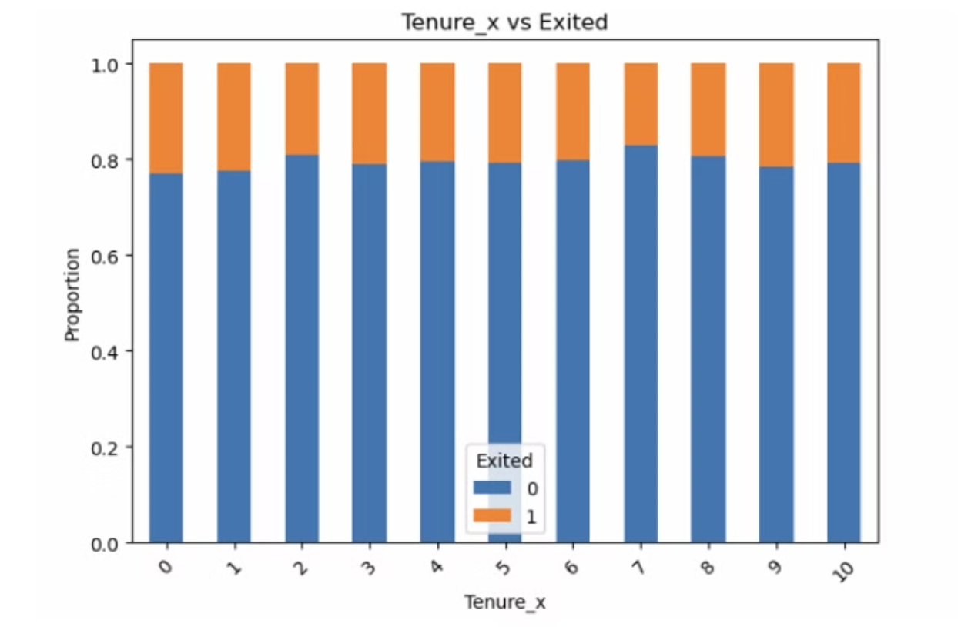
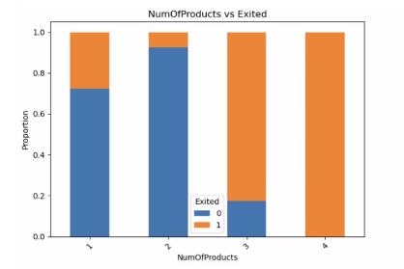
Discrete Variables and Churn Behaviour

Slide 13
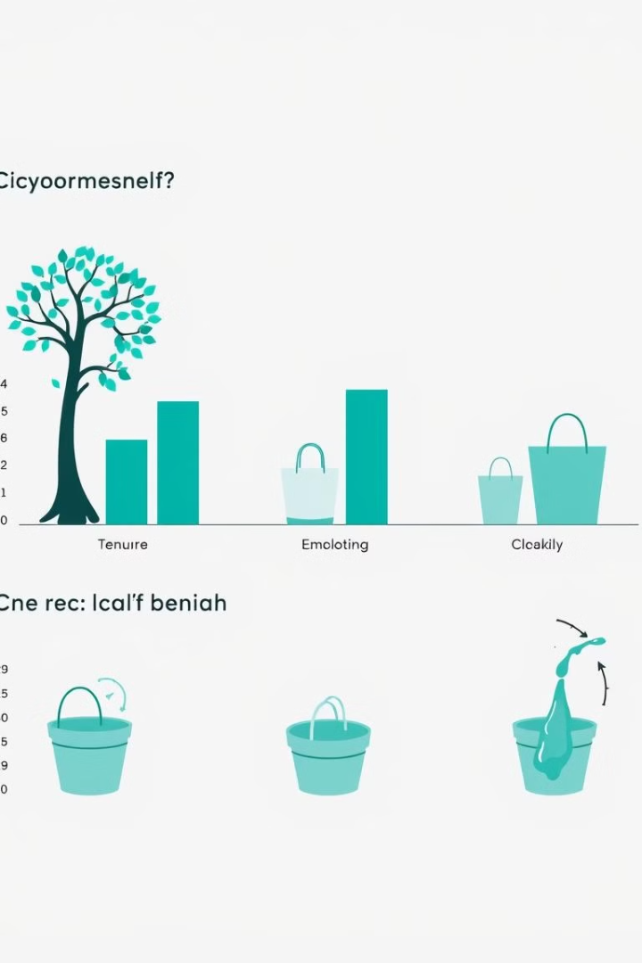




Discrete Variables and Churn Relationship
Tenure Impact
There is no indicative pattern between tenure and customer exits, suggesting loyalty duration may not be a primary factor in churn decisions.
Product Ownership (1-2)
Customers having 1 or 2 products tend to churn the least, indicating an optimal product range for customer satisfaction.
Product Ownership (3-4)
Customers with 3 or 4 products have churned more frequently than those with fewer products.
Maximum Products
Customers with 4 products have all churned, suggesting potential issues with over-selling or product compatibility.

Slide 14






Product Engagement and Churn
Multi-Product Users
Customers with multiple products show lower churn rates
Single Product Risk
Customers with fewer products are more likely to leave
Cross-Selling Opportunity
Encourage adoption of additional products to increase retention
The analysis shows a clear relationship between the number of products a customer has and their likelihood to churn. T-test results (T-statistic: 4.786984698423093, P-value: 1.717333004804293e-06) confirm that this relationship is statistically significant. Customers with only one product are at the highest risk of churning, while those with multiple products demonstrate stronger loyalty. This suggests that cross-selling additional relevant products could be an effective retention strategy. The bank should focus on identifying customers with single products and develop targeted campaigns to introduce them to complementary banking services.

Slide 15
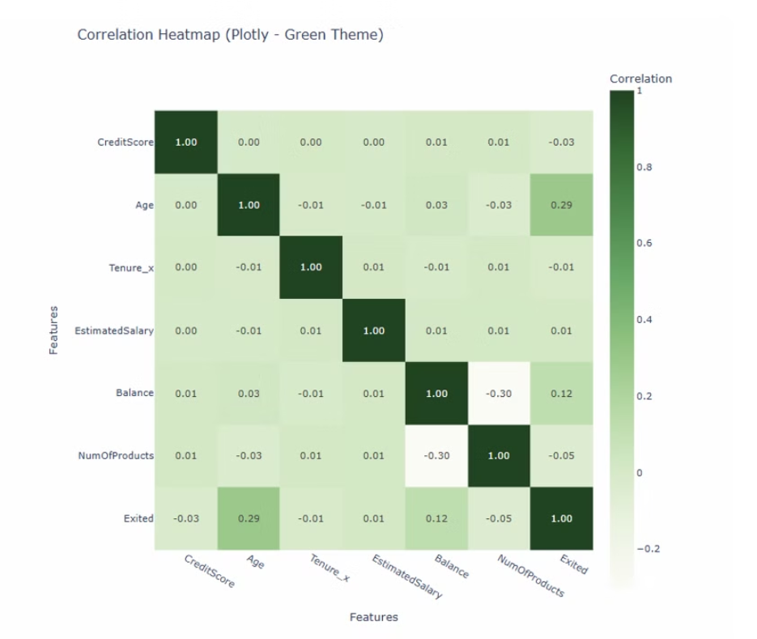
Pearson Correlation Heatmap

Slide 16








Numerical Variables Relationships
Correlation Analysis
Pearson Coefficient
Scatter plots and heatmap reveal no strong linear relationships between the numerical variables, as points are randomly scattered.
The Pearson r coefficient values are low to moderate, confirming limited linear correlation between variables.
Non-significant Variables
T-test Results
Statistical significance tests show Credit Score, Age, Balance, and NumOfProducts have significant relationships with customer churn.
Estimated Salary and Tenure do not show statistical significance in relation to customer exits.

Slide 17
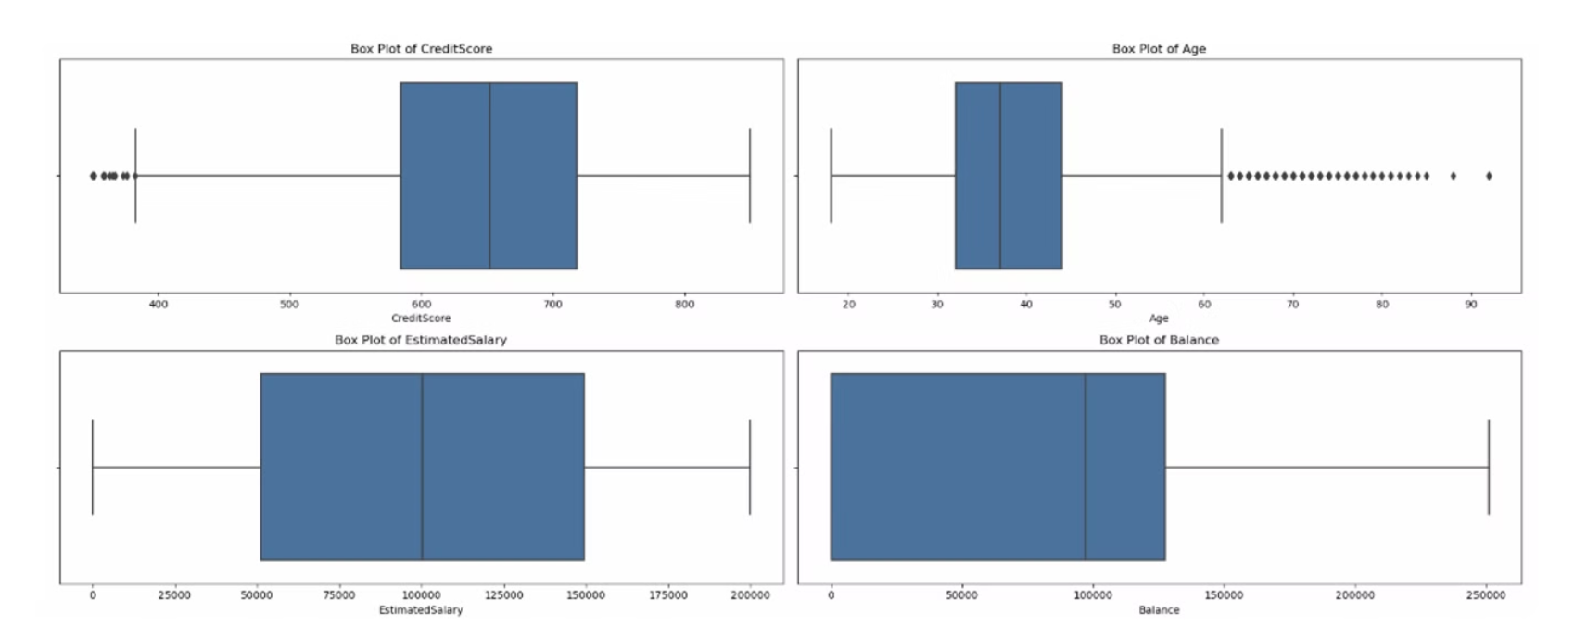
Boxplots

Slide 18




Distribution and Outlier Analysis
Credit Score and Age
Boxplots reveal some outliers in the credit score and age columns that may need special handling.
Estimated Salary
The estimated salary column appears normally distributed with minimal outliers.
Balance Distribution
The balance column is highly right-skewed, with many customers having low balances and a few with very high amounts.
Multivariable Analysis
Multivariable boxplots provide additional insights into the relationships between numerical variables and churn status.

Slide 19
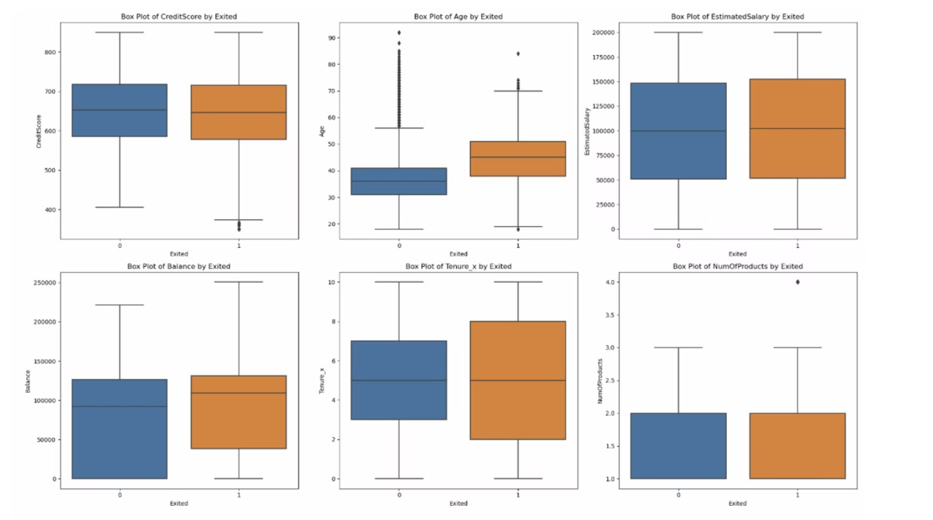

Slide 20



Credit Score Impact on Churn
Lower Credit Scores
Statistical Significance
Business Opportunity
Customers with credit scores below 400 tend to churn more frequently, suggesting financial instability may be a factor in customer exit.
T-test results (T-statistic: 2.7100778888729833, P-value: 0.006738213892192373) confirm that the difference in credit scores between churned and non-churned customers is statistically significant.
Consider offering tailored financial products to lower credit score segments to improve retention. Financial education and credit improvement programs could help retain these at-risk customers.
The boxplot analysis shows that while the median credit scores are similar between churned and non-churned customers, there's a notable difference in the lower quartile, with churned customers having slightly lower credit scores overall.

Slide 21
Balances V/S Churn
Higher Balances Still Churn
Customers with higher account balances still show significant churn rates, contrary to what might be expected. This suggests that financial engagement alone doesn't guarantee loyalty.
Statistical Evidence
T-test results (T-statistic: -11.936240300013841, P-value: 1.2755633191525477e-32) confirm a highly significant relationship between account balance and customer churn.
High-Value Customer Focus
Investigate why high-value customers with substantial balances are leaving. These customers represent significant value to the bank and should be prioritized in retention efforts.
Personalized Services
Consider implementing personalized services or rewards programs specifically for high-balance holders to increase their loyalty and reduce churn.
The balance distribution shows a highly right-skewed pattern, with most customers having moderate balances but some outliers with very high balances. Zero-balance accounts were also identified as a potential risk factor for churn.

Slide 22
Churn Behaviour by Age
Older Customers Churn More
The median age of exited customers is significantly higher (around 45) than non-exited customers (around 35-36), indicating that older customers are more likely to leave the bank.
Targeted Retention Needed
Develop specific programs for older customers to reduce churn. Investigate why older customers are leaving through surveys and interviews.
Adapt Offerings
Consider if current products and services meet the needs of older demographics. Analyze what keeps loyal older customers engaged.
Age-Based Segmentation
Use age as a key variable for targeted marketing and communication. Tailor messages and offers based on age groups.
The t-test results (T-statistic: -29.769245989831617, P-value: 1.1601008038066586e-186) confirm that the difference in age between churned and non-churned customers is highly statistically significant.

Slide 23
Model Performance And Metrics
🔍 Comparison Summary:
Metric
Train
Test
Accuracy
0.8170
0.7965
Precision
0.5488
0.5000
Recall
0.8141
0.7887
F1 Score
0.6534
0.6197
ROC AUC
0.9043
0.8644

Slide 25
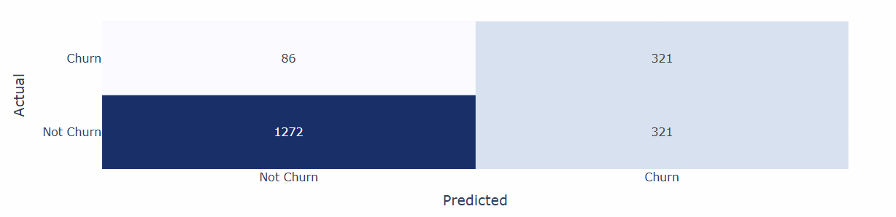
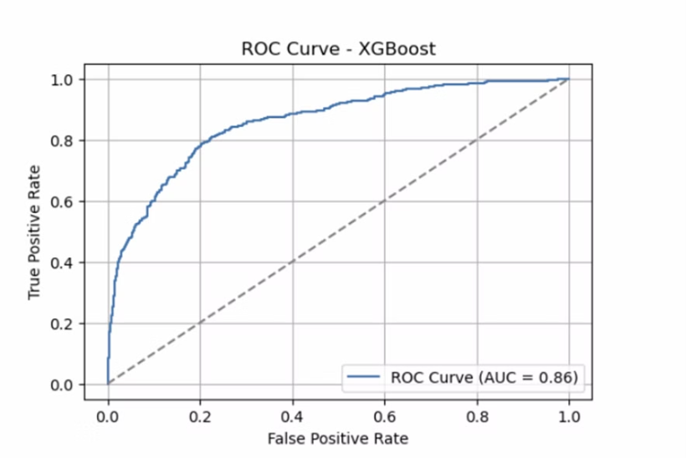
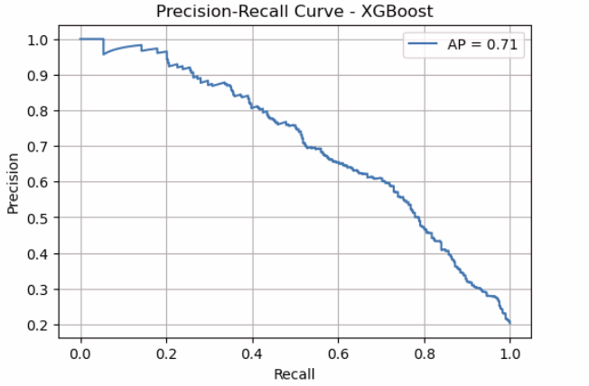
Model Performance and Insights

Slide 26
Model Performance and Business Insights
XGBoost Model Performance
80% accuracy with 75% recall for identifying churners
Key Churn Factors
Age, geography, product engagement, and activity status
Recommended Strategies
Age-based segmentation and targeted retention programs
The final XGBoost model achieved 80% accuracy with 79% recall for identifying customers likely to churn. The model showed strong ROC AUC performance (0.86), indicating good discriminative ability between churners and non-churners. Key business insights from the analysis include:
Focus retention efforts on older customers, particularly in Germany
Develop targeted programs for female customers who show higher churn rates
Encourage multi-product adoption to increase customer "stickiness",
Implement strategies to increase activity levels among dormant accounts,
Consider special attention to customers with lower credit scores or zero balances.

Slide 27
Recommendations for Improving Customer Retention
Regional Strategy
Develop targeted retention programs for German customers, who show the highest churn rates. Investigate regional-specific issues affecting customer satisfaction.
Gender-Specific Initiatives
Create tailored services and communication strategies for female customers, who are more likely to churn. Conduct surveys to understand their specific needs.
Credit Card Promotion
Encourage credit card adoption through targeted benefits and incentives, as non-cardholders
show higher churn rates.
Product Optimization
Limit product offerings to 1-2 per customer, as those with 3-4 products show significantly higher churn. Focus on product quality and relevance rather than quantity.
Engagement Programs
5
Implement robust customer engagement initiatives to convert passive customers into active members, as inactive members are more likely to leave.

Slide 28
Thankyou

